Slide 1

CSCI 476: Computer Security
Lecture 10: Sniffing, Spoofing, TCP/IP Attacks
Reese Pearsall
Fall 2022
https://www.cs.montana.edu/pearsall/classes/fall2022/476/main.html

Slide 2
Announcement
If I haven’t responded to a DM/email, please poke me about it
XSS Lab due Monday October 31st @ 11:59 PM
The worm task coming soon
TCP/IP Sniffing/Spoofing Lab due Sunday Nov 6th
Make sure your lab screenshots include the command you ran ☺

Slide 3



The Internet
Brief Review of
Query parameters can be passed via URL or in an HTTP request
protocol://hostname[:port]/[path/]file[?color=red&type=suv]
Communication of the web:
URL
Client
Server
HTTP Request:
Format: Method, Headers, Body
Methods: GET, POST, HAD, UPDATE
Headers: Host, referrer, User-agent, Cookie…
HTTP Response:
Format: Status, Response Headers, Body
Status Codes: 2xx (successful), 3xx (redirect), 4xx (bad request), 5xx (server error)
Server-side functionality
Serve static resources (HTML, CSS, Images)
Serve dynamic Resources (PHP, Ruby, Java, Javascript…)
Query Databases
Relational (MySql)
Non-Relational (MongoDB)
Big Idea: Our input data gets passed to another host through URL parameters and an HTTP requests
Database

Slide 4

Router
SRC
HTPP Request
GET WWW.BLAH.COM
Headers
Body
Sending our packet to a destination is not a simple task
DST

Slide 5
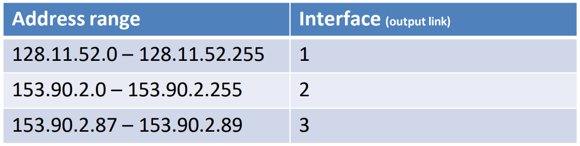


Router
SRC
HTPP Request
GET WWW.BLAH.COM
Headers
Body
Sending our packet to a destination is not a simple task
Our packet will travel through routers, which help forward our packet to the correct destination
DST

Slide 6
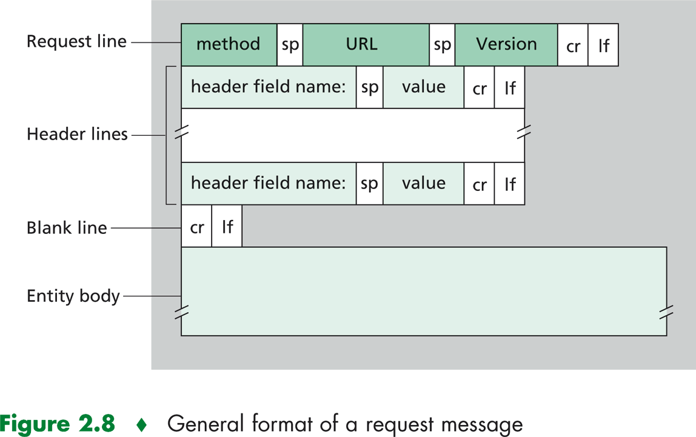
There is a lot of stuff that gets added onto our data being send
HTPP Request
GET WWW.BLAH.COM
Headers
Body
“User Data”

Slide 7




There is a lot of stuff that gets added onto our data being send
HTPP Request
GET WWW.BLAH.COM
Headers
Body
“User Data”
A packet arriving to a machine needs to know which process/application to go to
???

Slide 8


There is a lot of stuff that gets added onto our data being send
GET WWW.BLAH.COM
Headers
HTPP Request
Body
Port 80
Port 222
Port 6001
TCP Header
Each application is bound to a port, so each packet will need to know what port they need to go to

Slide 9



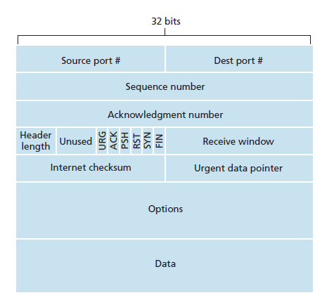
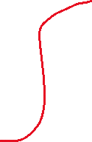


There is a lot of stuff that gets added onto our data being send
GET WWW.BLAH.COM
Port 80
Port 222
Port 6001
Headers
HTPP Request
Body
TCP Header

Slide 10
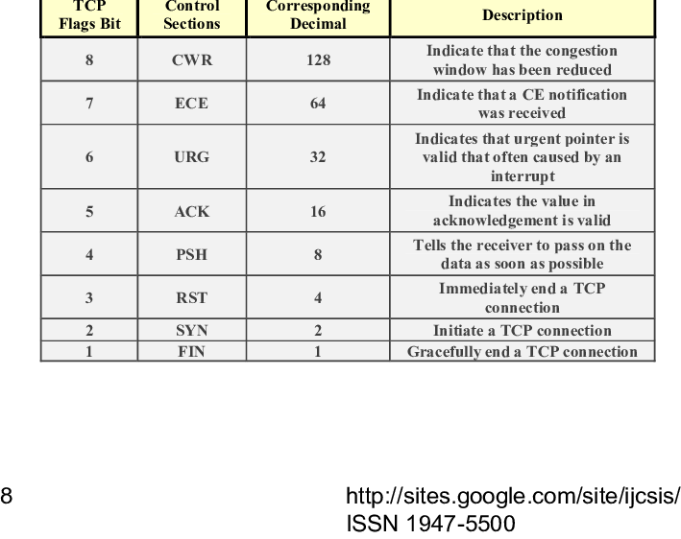
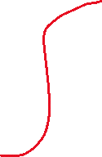
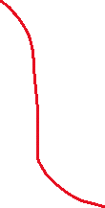



There is a lot of stuff that gets added onto our data being send
GET WWW.BLAH.COM
Port 80
Port 222
Port 6001
Headers
HTPP Request
Body
TCP Header

Slide 11









There is a lot of stuff that gets added onto our data being send
We also need to know which device to send to → IP Address
GET WWW.BLAH.COM
Headers
HTPP Request
Body
TCP Header
10.9.0.5

Slide 12
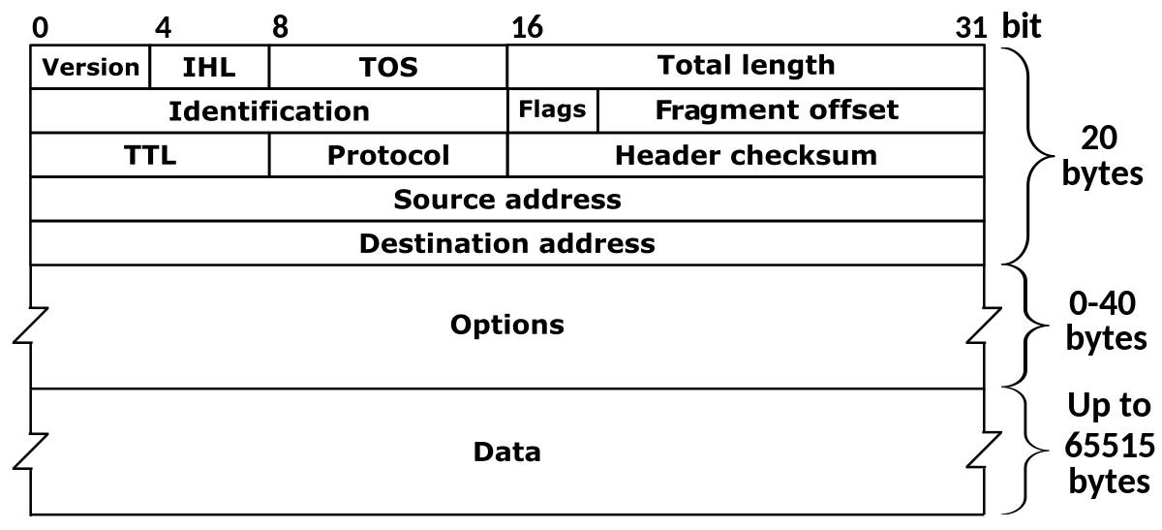













There is a lot of stuff that gets added onto our data being send
We also need to know which device to send to → IP Address
GET WWW.BLAH.COM
Headers
HTPP Request
Body
TCP Header
10.9.0.5
IP Header
Our packet eventually gets the IP address

Slide 13
There is a lot of stuff that gets added onto our data being send
Routers maintain a table that will forward a packet to the next router based on the packet’s destination IP address*
We also need to know which device to send to → IP Address
GET WWW.BLAH.COM
Headers
HTPP Request
Body
TCP Header
10.9.0.5
IP Header

Slide 14
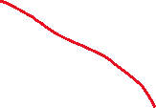



There is a lot of stuff that gets added onto our data being send
Routers maintain a table that will forward a packet to the next router based on the packet’s destination IP address*
We also need to know which device to send to → IP Address
GET WWW.BLAH.COM
Headers
HTPP Request
Body
10.9.0.0/24
TCP Header
10.9.0.2
IP Header
10.9.0.1
10.9.0.3
Devices in a subnet share a common prefix for their IP addresses
10.9.0.4

Slide 15

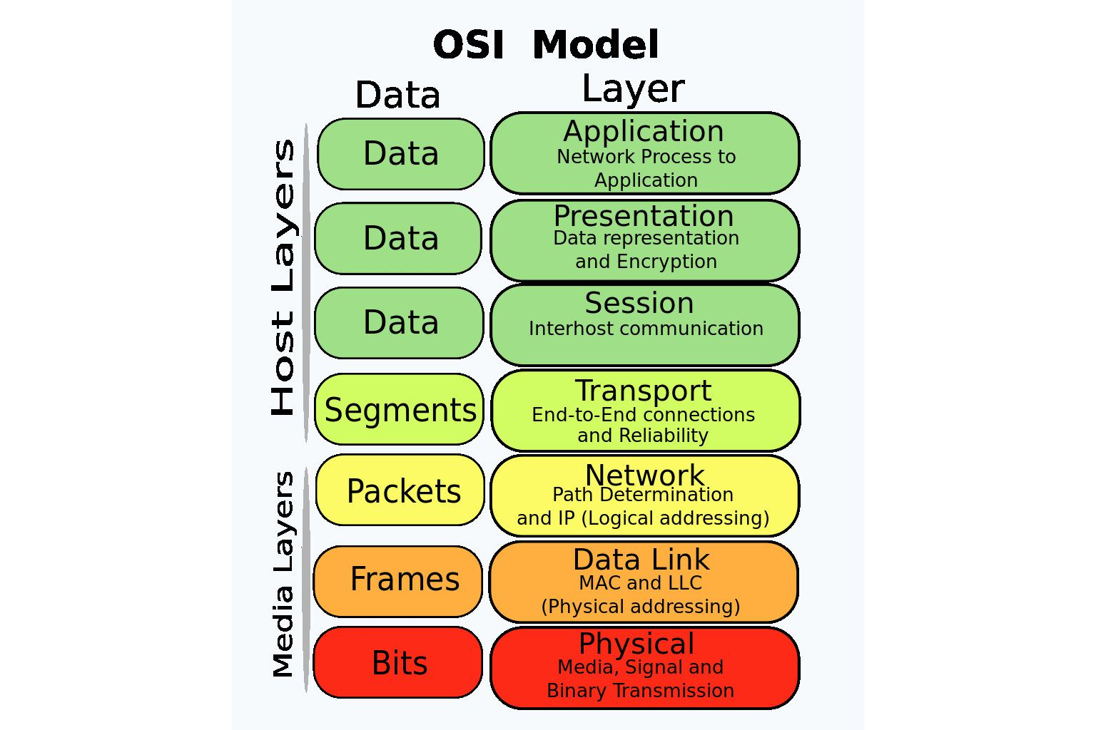
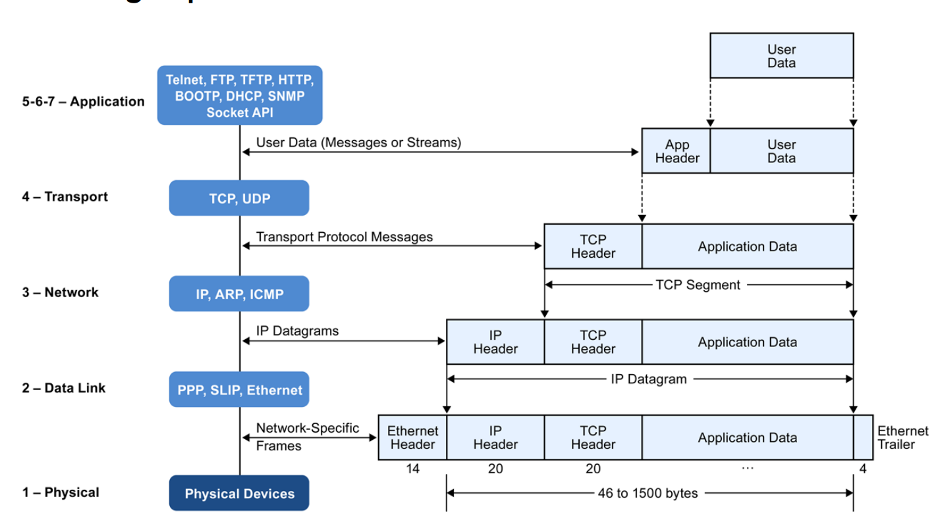






The Journey of a packet
Packets are encapsulated in various protocol layers; each has a header and payload
Our focus will be on the transport layer (TCP/UDP) and the network layer (IP)

Slide 16







The Journey of a packet
Packets are encapsulated in various protocol layers; each has a header and payload
Our focus will be on the transport layer (TCP/UDP) and the network layer (IP)

Slide 17
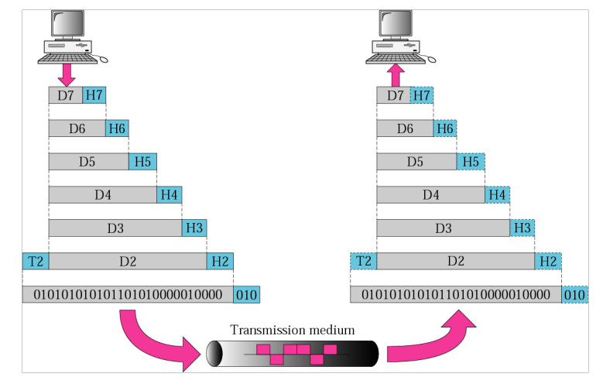
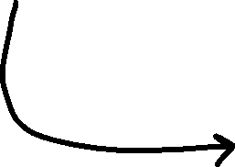


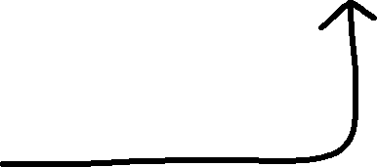
WIFI, Fiber optic, Copper Wire, Birds
** Many devices are sharing this medium

Slide 18
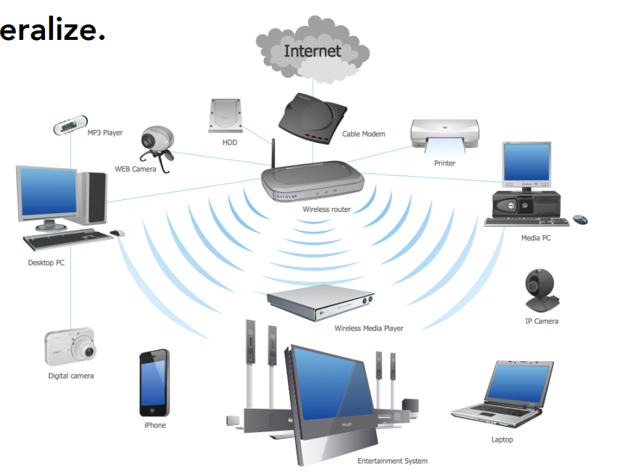
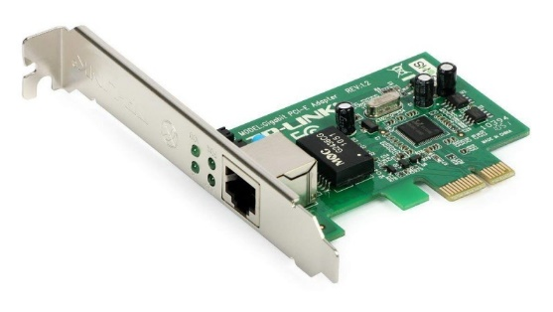
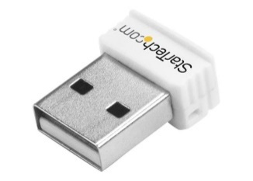
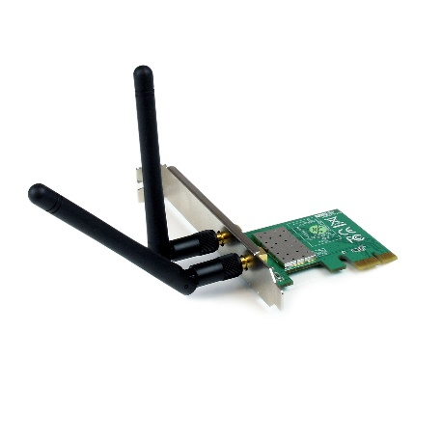
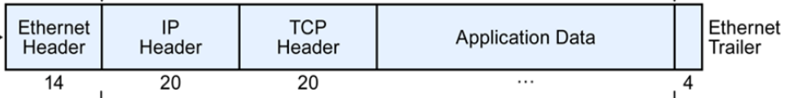


Devices connect to a network via a Network Interface Card (NIC)
25-6B-78-1D-A0-57
Each NIC as a Medium Access Control (MAC) address
Every NIC “hears” all the frames “on the wire” (or “in the air”)
NIC checks destination (dst) address of the packet’s link layer header
Accept packets that match the NIC’s MAC address, “drop” other packets
25-6B-78-1D-A0-57
41-91-31-CB-F0-BD

Slide 19
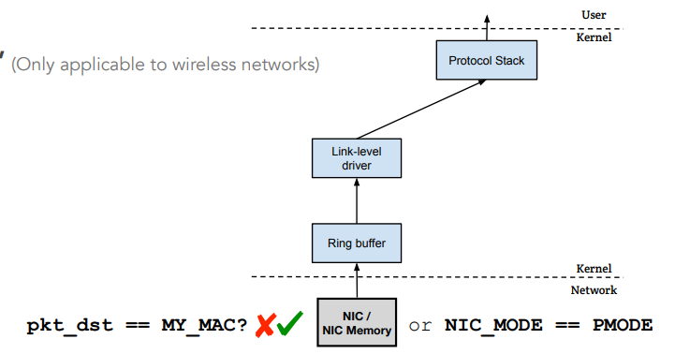


How do we get all the network traffic?
Promiscuous Mode
• Frames that are not destined to a given NIC are normally discarded
• When operating in promiscuous mode, the NIC passes every frame received from the network to the kernel
• If a sniffer program is registered with the kernel, it will be able to see all the packets
There are tons of packets. We don’t need all of them…
The interesting ones are TCP, UDP, DNS, HTTPS
Lets start “sniffing” for packets!
Wireshark is the most popular packet sniffing and analysis tool

Slide 20

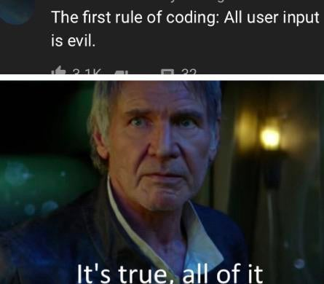
Announcement
If I haven’t responded to a DM/email, please poke me about it
XSS Lab due Monday October 31st @ 11:59 PM
TCP/IP Sniffing/Spoofing Lab due Sunday Nov 6th

Slide 21
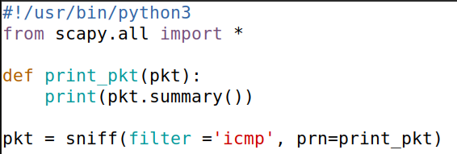
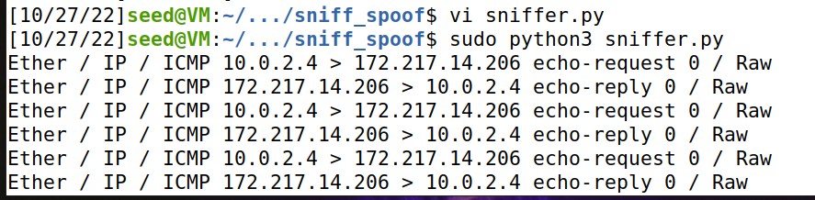
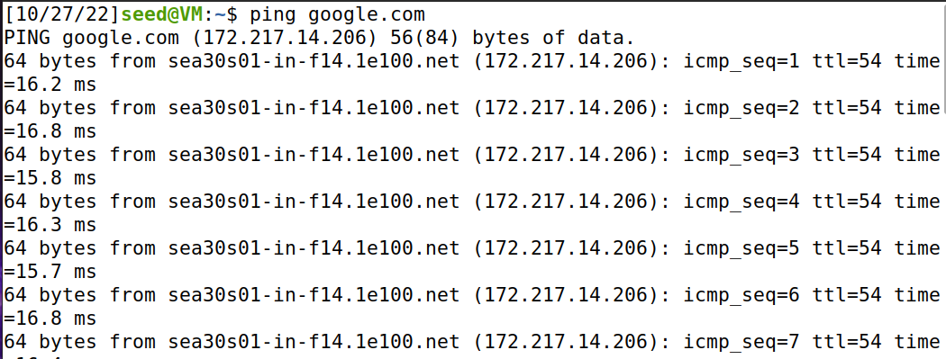
Sniffing in Python
sniffer.py
Run our sniffer program (sudo is needed)
In another terminal, run the ping command to create some ICMP packets
Our program is picking up the ICMP packets!!

Slide 22
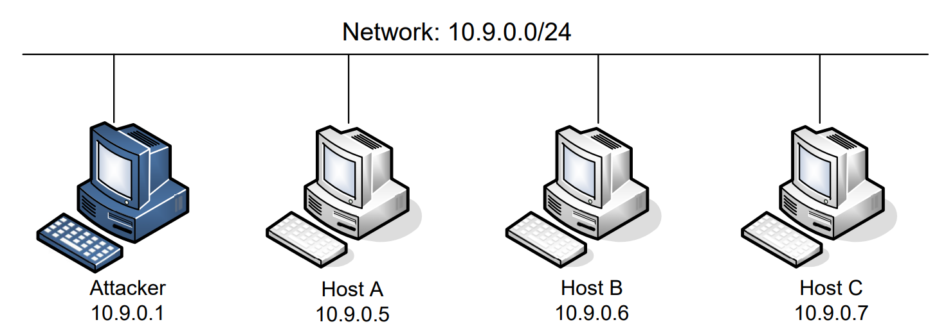
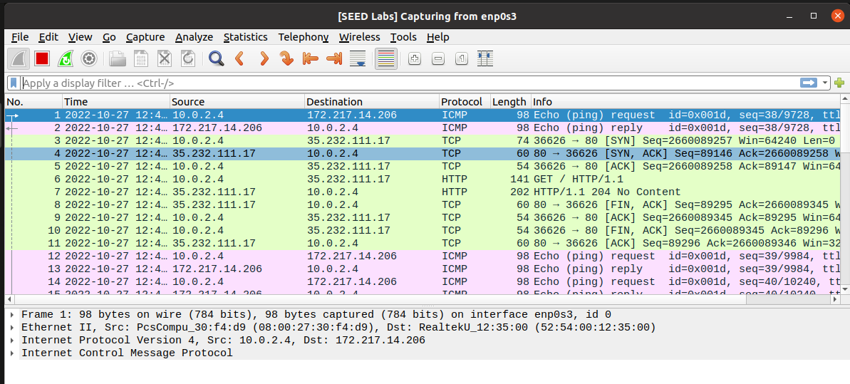
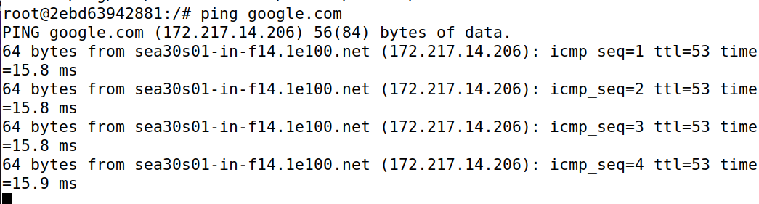
Setup
docker-compose up -d
On the attacker machine, we can also see these packets in Wireshark!
dock sh 2ebd
For this lab, we will logged into our attacker machine (our VM) and logged into a victim machine (a container)

Slide 23
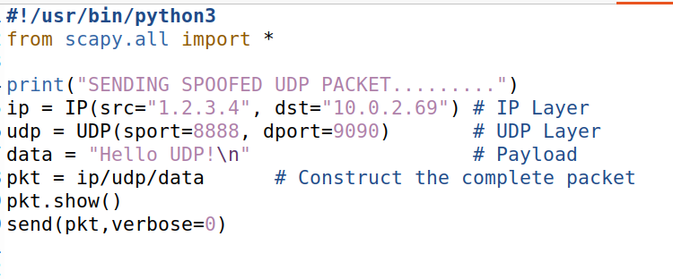
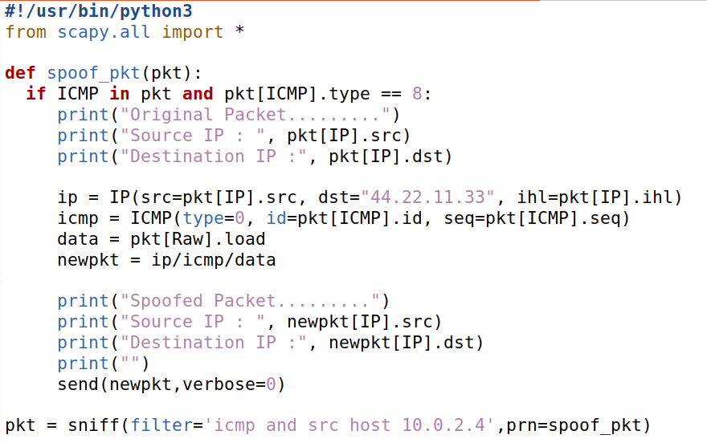
1
Sniff/listen for ICMP packets coming from 10.0.2.4
udp_spoof.py
2
When we intercept an ICMP packet, extract the packets source IP, and then create a spoofed packet
44.22.11.33 will receive a packet from 10.0.2.4
1
2
icmp_sniff_spoof.py
1
We can set the packets source IP and destination IP
Souce ip: 1.2.3.4 (bogus)
Destination IP: 10.0.2.69 (also bogus)
2
We can set the packets source port and destination port (udp)
2
Source port: 8888 (bogus)
Destination port: 9090 (also bogus)
1

Slide 24

Attacks on TCP
SYN Flooding
SYN Reset
TCP session hijack
me
Please don’t try to do this stuff on real servers outside of the VM

Slide 25

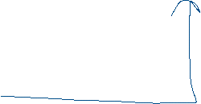
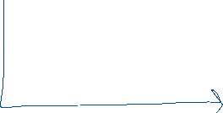
Application Layer
HTTP Request
Application Layer
Transport Layer
TCP Connection
Transport Layer
Network Layer
Network Layer
…
When using the internet, you are commonly using a TCP protocol. You (a TCP client) connect to a TCP server to exchange information to ensure delivery
…
(Session layer and presentation are not included in this graphic)

Slide 26
Application Layer
HTTP Request
Application Layer
Transport Layer
TCP Connection
Transport Layer
Network Layer
Network Layer
When using the internet, you are commonly using a TCP protocol. You (a TCP client) connect to a TCP server to exchange information to ensure delivery
This process of establishing a TCP connection has a very specific process → TCP Handshake
(Session layer and presentation are not included in this graphic)

Slide 27
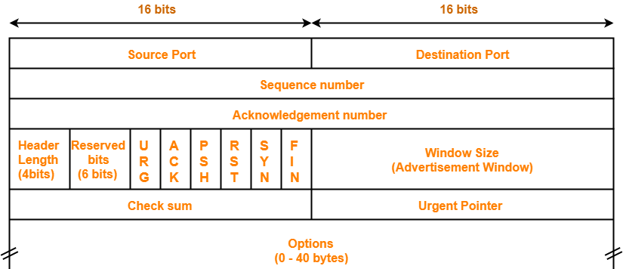
TCP Client
TCP Server
TCP Header
Data
Packet

Slide 28

TCP Client
SYN
TCP Server
TCP Header
Data
SYN flag is set!
TCP Handshake:
Client sends a SYN to the server
Packet

Slide 29


TCP Client
SYN
TCP Server
SYN + ACK
TCP Header
TCP Handshake:
Client sends a SYN to the server
Server sends back a SYN + ACK
Data
SYN flag is set!
ACK flag is set!
Packet

Slide 30

TCP Client
SYN
TCP Server
SYN + ACK
ACK
TCP Header
TCP Handshake:
Client sends a SYN to the server
Server sends back a SYN + ACK
Client sends back an ACK
Data
ACK flag is set!
Packet

Slide 31
TCP Client
SYN
TCP Server
SYN + ACK
ACK
(Data can start being sent!)
TCP Header
TCP Handshake:
Client sends a SYN to the server
Server sends back a SYN + ACK
Client sends back an ACK
Data
ACK flag is set!
Packet

Slide 32
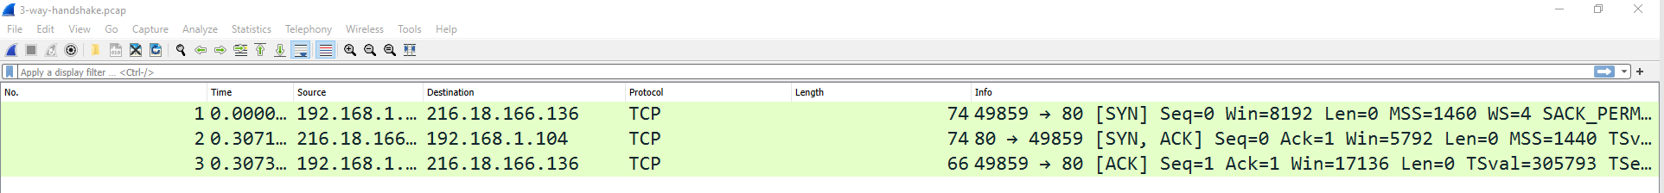






You can see this happening in Wireshark
SYN = 0
SYN = 0 + ACK = 1
ACK = 1

Slide 33
Let’s do some evil stuff
The Achilles heel:
TCP servers will accept SYN requests, send out SYN+ACK, and wait to receive an ACK
TCP Client
TCP Server

Slide 34

Let’s do some evil stuff
The Achilles heel:
TCP servers will accept SYN requests, send out SYN+ACK, and wait to receive an ACK
TCP Client
TCP Server
SYN
SYN + ACK
Waiting for an ACK…

Slide 35
Let’s do some evil stuff
The Achilles heel:
TCP servers will accept SYN requests, send out SYN+ACK, and wait to receive an ACK
TCP Client
TCP Server
SYN
SYN + ACK
SYN + ACK
Waiting for an ACK…
SYN + ACK
If it does not get an ACK after some amount of time, it will retransmit

Slide 36
Let’s do some evil stuff
The Achilles heel:
TCP servers will accept SYN requests, send out SYN+ACK, and wait to receive an ACK
TCP Client
TCP Server
SYN
SYN + ACK
SYN + ACK
Waiting for an ACK…
SYN + ACK
If it does not get an ACK after some amount of time, it will retransmit
How many times should we retransmit before giving up?
Set by the operating system!

Slide 37
Let’s do some evil stuff
The Achilles heel:
TCP servers will accept SYN requests, send out SYN+ACK, and wait to receive an ACK
TCP Client
TCP Server
SYN
The TCP server will hold our request until we drop it
SYN + ACK
SYN + ACK
TCP Request SYN Queue
SYN + ACK
There is a time period where our request is held in the SYN queue before it is dropped
SYN + ACK
SYN + ACK
SYN + ACK

Slide 38
Let’s do some evil stuff
The Achilles heel:
TCP servers will accept SYN requests, send out SYN+ACK, and wait to receive an ACK
TCP Client
TCP Server
SYN
The TCP server will hold our request until we drop it
SYN + ACK
SYN + ACK
TCP Request SYN Queue
SYN + ACK
There is a time period where our request is held in the SYN queue before it is dropped
SYN + ACK
SYN + ACK
SYN + ACK
What can we do with our knowledge of spoofing?

Slide 39
Let’s do some evil stuff
The Achilles heel:
TCP servers will accept SYN requests, send out SYN+ACK, and wait to receive an ACK
TCP Client
TCP Server
SYN
The TCP server will hold our request until we drop it
SYN + ACK
SYN + ACK
TCP Request SYN Queue
SYN + ACK
There is a time period where our request is held in the SYN queue before it is dropped
SYN + ACK
SYN + ACK
What can we do with our knowledge of spoofing?
SYN + ACK
Send out a lot of SYN requests from spoofed source IP address

Slide 40
Let’s do some evil stuff
The Achilles heel:
TCP servers will accept SYN requests, send out SYN+ACK, and wait to receive an ACK
TCP Client
TCP Server
SYN
The TCP server will hold our request until we drop it
SYN
SYN
SYN
TCP Request SYN Queue
SYN
We can quickly the SYN queue buffer with our spoofed request
SYN
SYN
The TCP server will hold those requests in the queue while it waits
SYN
SYN

Slide 41
Let’s do some evil stuff
The Achilles heel:
TCP servers will accept SYN requests, send out SYN+ACK, and wait to receive an ACK
TCP Client
TCP Server
SYN
The TCP server will hold our request until we drop it
SYN
SYN
SYN
TCP Request SYN Queue
SYN
We can quickly the SYN queue buffer with our spoofed request
SYN
SYN
The TCP server will hold those requests in the queue while it waits
SYN
SYN
If the buffer is full…

Slide 42
Let’s do some evil stuff
The Achilles heel:
TCP servers will accept SYN requests, send out SYN+ACK, and wait to receive an ACK
TCP Client
TCP Server
SYN
The TCP server will hold our request until we drop it
SYN
SYN
SYN
TCP Request SYN Queue
SYN
We can quickly the SYN queue buffer with our spoofed request
SYN
SYN
The TCP server will hold those requests in the queue while it waits
SYN
SYN
If the buffer is full…
The TCP server won’t be able to accept new connections!

Slide 43
Let’s do some evil stuff
The Achilles heel:
TCP servers will accept SYN requests, send out SYN+ACK, and wait to receive an ACK
TCP Client
TCP Server
SYN
The TCP server will hold our request until we drop it
SYN
SYN
SYN
TCP Request SYN Queue
SYN
We can quickly the SYN queue buffer with our spoofed request
SYN
SYN
The TCP server will hold those requests in the queue while it waits
SYN
SYN
If the buffer is full…
The TCP server won’t be able to accept new connections!

Slide 44
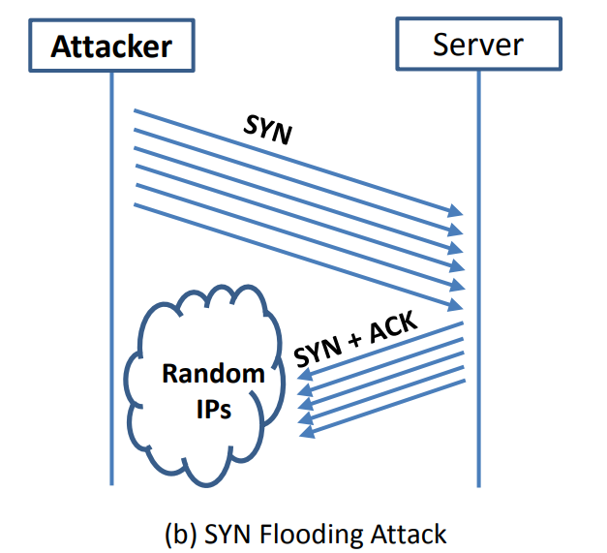
Let’s do some evil stuff
(The size of this buffer is also set by the operating system)
If a new SYN comes in (from a legitimate user), they will be denied

Slide 45
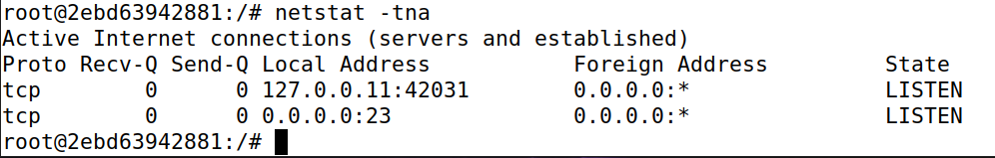
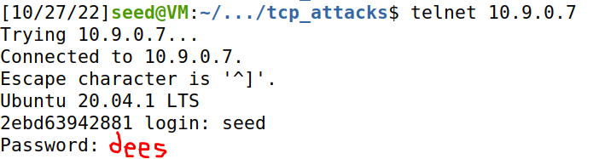
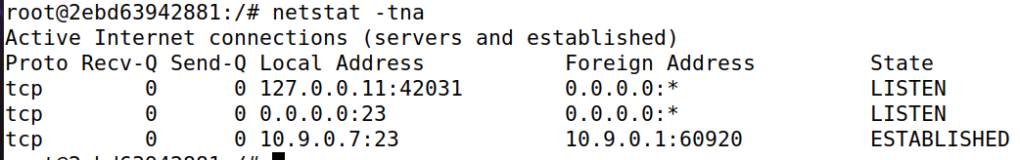



Turn off countermeasures…
sysctl –w net.ipv4.tcp_syncookies = 0
Turn off SYN cookies
Use netstat to see the current status of server’s TCP connections
From another machine, use telnet to establish a TCP connection

Slide 46
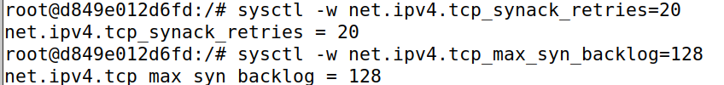
We will also increase the number of retries (SYN + ACK) the server will do before giving up
AND
Make the SYN queue smaller

Slide 47
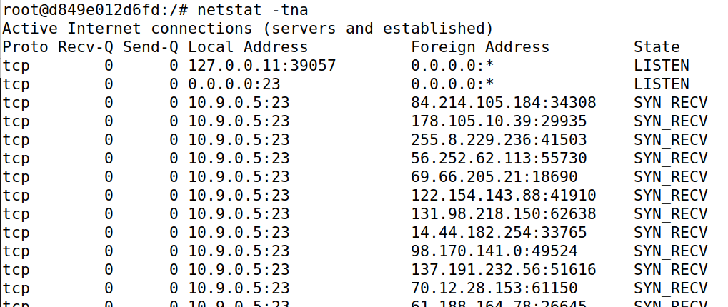
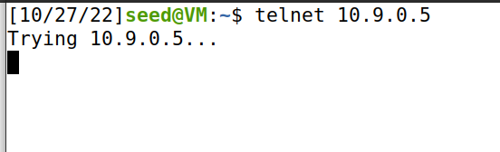
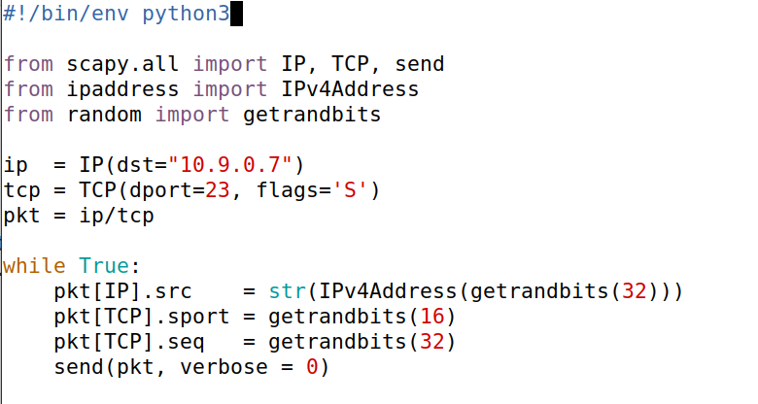
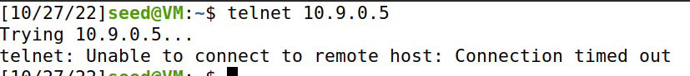



Victim Server
Attacker
New terminal
Server is full!
synflood.py
We’ve filled this server with spoofed SYN requests
Denied
1
Repeatedly send a TCP packet to 10.9.0.7, with a random source IP address
1

Slide 48
Issues:
We had to change the number of retries/queue size to make this attack easier for us
If the number of retries is low, and the waiting queue is large… we might not fill it in time!

Slide 49
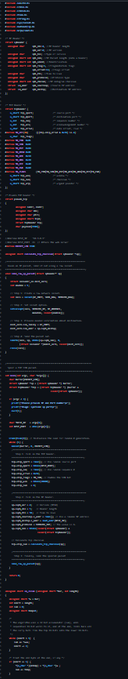
Issues:
synflood.c
We had to change the number of retries/queue size to make this attack easier for us
If the number of retries is low, and the waiting queue is large… we might not fill it in time!
Solution?
Use C (lmao)

Slide 50
Issues:
synflood.c
We had to change the number of retries/queue size to make this attack easier for us
Countermeasures
SYN Cookies- Allocate server resources only for established connections
If the number of retries is low, and the waiting queue is large… we might not fill it in time!
Waiting…
ACK received!
Solution?
Use C (lmao)
TCP Request SYN Queue

Slide 51
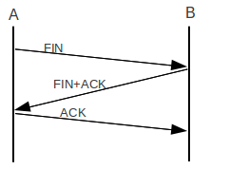

TCP Reset Attack
Goal: Break an established TCP connection by sending a spoofed RESET (RST) packet
This is different than sending a FIN packet
TCP Header
Data
Packet

Slide 52
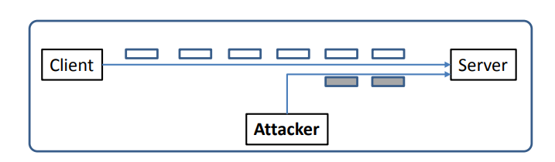
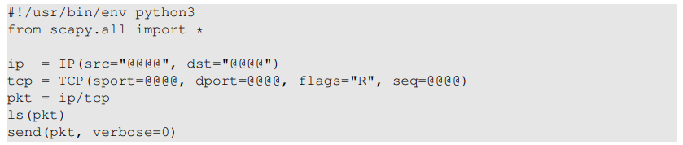

TCP Reset Attack
In order to do our attack, we first need to find an ongoing TCP communication between two users!
A server reads data in some order (typically by sequence number)
10.9.0.6
10.9.0.5
SEQ # = 4440
10.9.0.1
If the server gets a SEQ# of something below 4440, it will ignore it
In our spoofed packet, we need to make sure we select a sequence number that matches the sequence number the server is expecting!
(@@@ are placeholder. You will fill them in)
We also need to select the same ports!

Slide 53
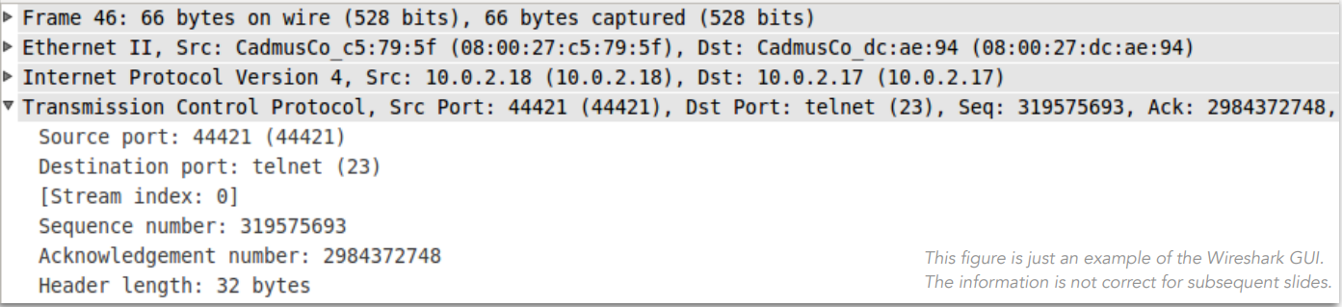

TCP Reset Attack
In order to do our attack, we first need to find an ongoing TCP communication between two users!
A server reads data in some order (typically by sequence number)
10.9.0.6
10.9.0.5
10.9.0.1
We can pull this information from wireshark!
On the attack, do telnet to access victim server

Slide 54
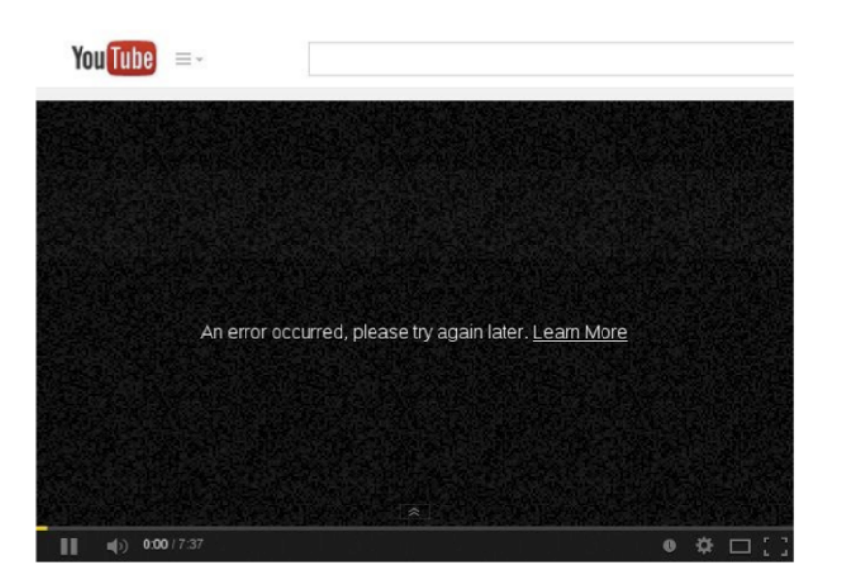
TCP Reset Attack

Slide 55
Announcements
Lab 7 Due Thursday November 10th (Need to update website)
No class on Tuesday next week (11/8)
Sorry for some weird code issues on the XSS lab
Course Roadmap
Lab 7 TCP Attacks (11/10)
Lab 8 Symmetric Crypto (11/20)
Lab 9 Hashing (12/2)
Research Project (12/8)
Final Exam Tuesday December 13th @ 2:00 – 3:50 PM in Reid 102
→ Will review as we get closer to end of semester

Slide 56
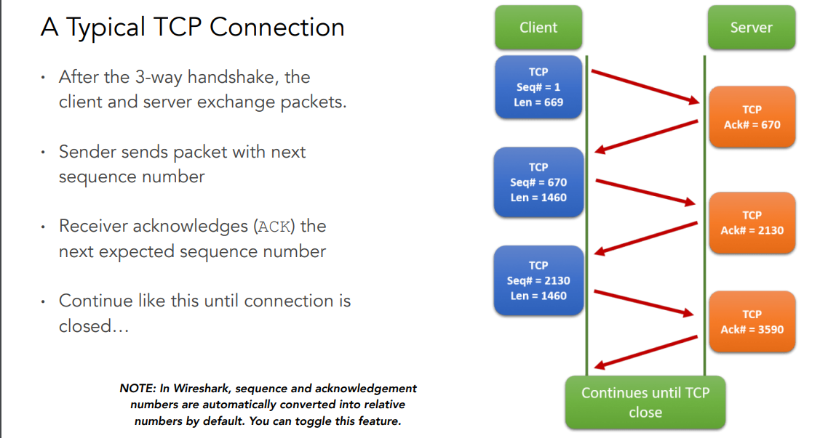
TCP Conversation

Slide 57
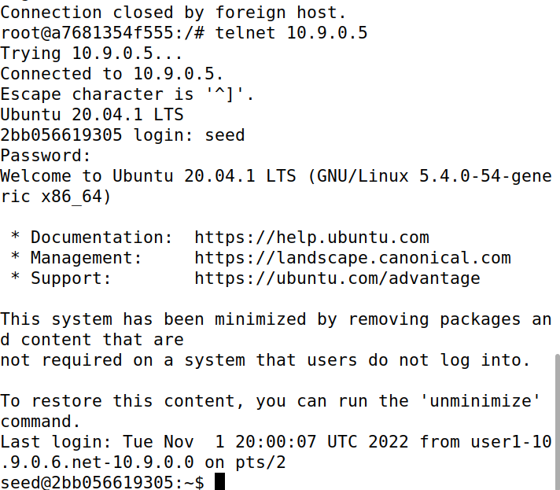

TCP Reset Attack
We need the information to generate our spoofed packet:
1. Open up Wireshark, and start generating some TCP traffic between Client 1 container and victim server
Logged into the user 1 container
Look at the most recent packet sent between client and server
Your information may be different
10.9.0.6
10.9.0.5
Port 38724
Port 23
Telnet connection established
10.9.0.1

Slide 58




TCP Reset Attack
We need the information to generate our spoofed packet:
Open up Wireshark, and start generating some TCP traffic between Client 1 container and victim server
Fill in src IP, dst IP, src port, dst port, and sequence number into reset.py
Your information will be different
10.9.0.6
10.9.0.5
Port 38724
Port 23
10.9.0.1

Slide 59



TCP Reset Attack
We need the information to generate our spoofed packet:
Open up Wireshark, and start generating some TCP traffic between Client 1 container and victim server
Fill in src IP, dst IP, src port, dst port, and sequence number into reset.py
Hop back to client 1 container, press enter, connection should be closed!
Your information will be different
10.9.0.6
10.9.0.5
Port 38724
Port 23
10.9.0.1

Slide 60
TCP Hijack Attack
Hijack a current TCP connection and get a TCP server to execute commands of our choice
Open up Wireshark, and start generating some TCP traffic between Client 1 container and victim server
Look at most recent TCP/Telnet Packet in Wireshark
Just like with the TCP reset, we need this information for our packet
Your information will be different

Slide 61
TCP Hijack Attack
Hijack a current TCP connection and get a TCP server to execute commands of our choice
Open up Wireshark, and start generating some TCP traffic between Client 1 container and victim server
Look at most recent TCP/Telnet Packet in Wireshark
Just like with the TCP reset, we need this information for our packet
Your information will be different
For TCP Hijack, we will also be sending a command to run. What commands could we run?

Slide 62
TCP Hijack Attack
Hijack a current TCP connection and get a TCP server to execute commands of our choice
Open up Wireshark, and start generating some TCP traffic between Client 1 container and victim server
Look at most recent TCP/Telnet Packet in Wireshark
Just like with the TCP reset, we need this information for our packet
Your information will be different
For TCP Hijack, we will also be sending a command to run. What commands could we run?
We could steal a file (demo), or we could create a root shell reverse shell

Slide 63

TCP Hijack Attack
Hijack a current TCP connection and get a TCP server to execute commands of our choice
Open up Wireshark, and start generating some TCP traffic between Client 1 container and victim server
Look at most recent TCP/Telnet Packet in Wireshark
Fill in packet information in sessionhijack.py

Slide 64
TCP Hijack Attack
Hijack a current TCP connection and get a TCP server to execute commands of our choice
Open up Wireshark, and start generating some TCP traffic between Client 1 container and victim server
Look at most recent TCP/Telnet Packet in Wireshark
Fill in packet information in sessionhijack.py\
Summon a netcat server on attack machine (separate terminal)
netcat –lnv 9090

Slide 65

TCP Hijack Attack
Hijack a current TCP connection and get a TCP server to execute commands of our choice
Open up Wireshark, and start generating some TCP traffic between Client 1 container and victim server
Look at most recent TCP/Telnet Packet in Wireshark
Fill in packet information in sessionhijack.py\
Summon a netcat server on attack machine (separate terminal)
Run session hijack program
TCP server sent us the output of the cat command!

Slide 66

Reverse Shell
A reverse shell gives us (an attacker) a bash shell that we can remotely use → Total control!!
In our spoofed packet, that will be the command that we want to run!
(remember to have netcat server also running!)

